Slide 1
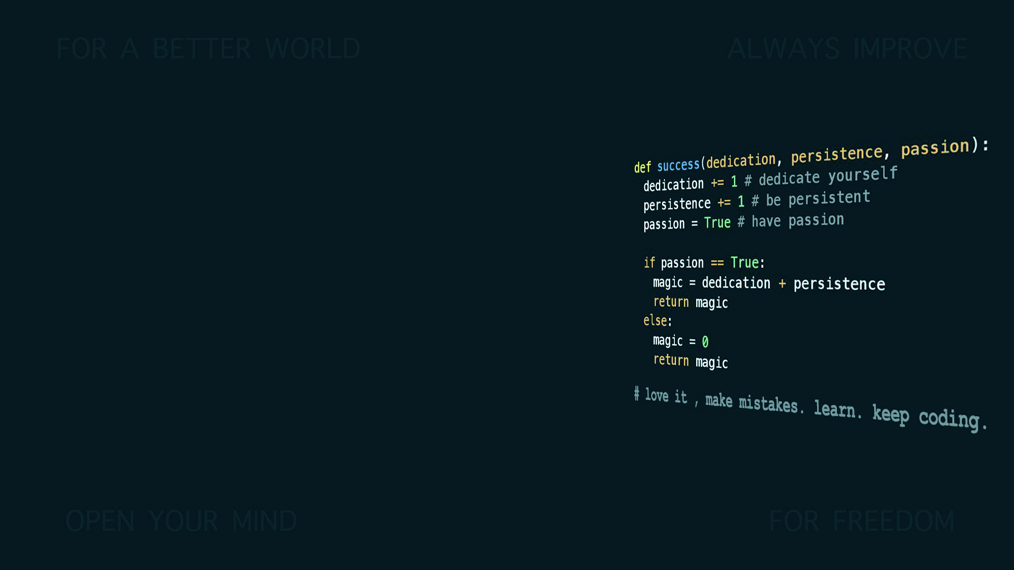
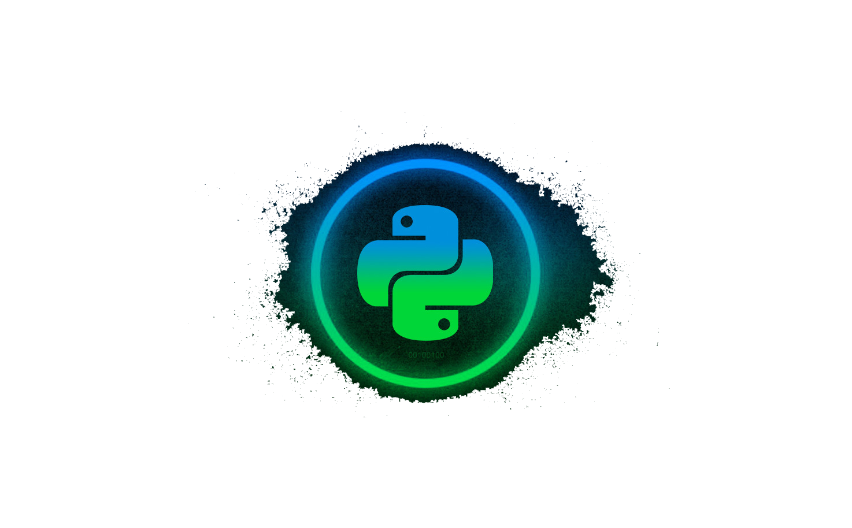
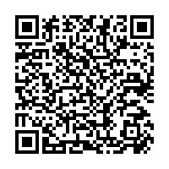

Introduction to Programming in Python
Master’s Universal Design of ICT
Abhijeet Sapkota
GitHub link:
(https://github.com/makeriet/Introduction-to-programming-in-python)

Slide 2
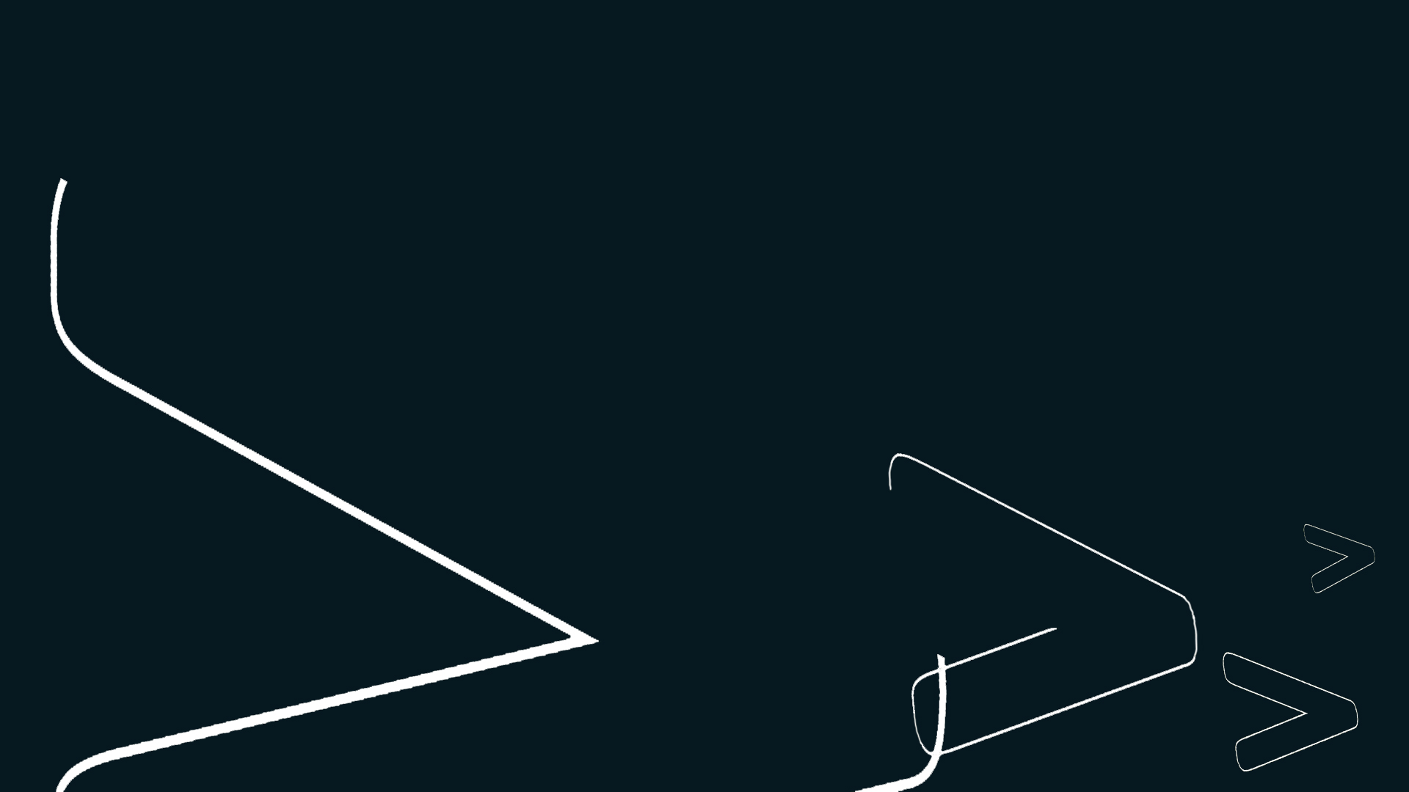
‘Python’ programming language
Clear and powerful programming language
Elegant syntax, making program code easier to read
Comes with large standard library
Interactive mode for short snippet of code
Notes:
Python Syntax (Data and Expressions)
Control Structures and Conditions
Functions
File handling

Slide 3
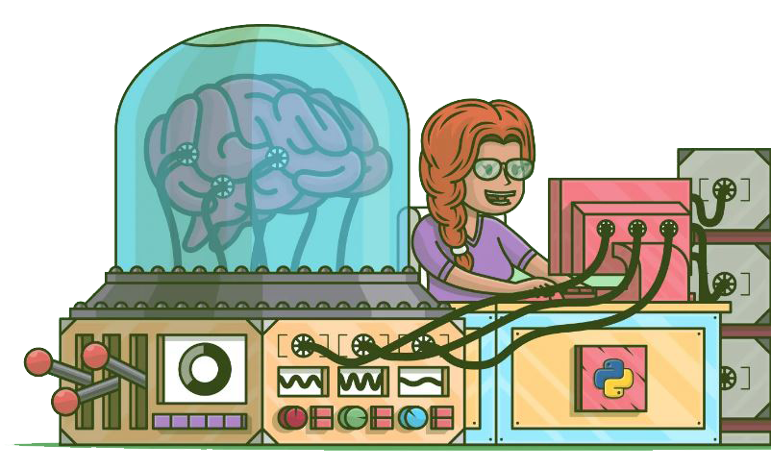
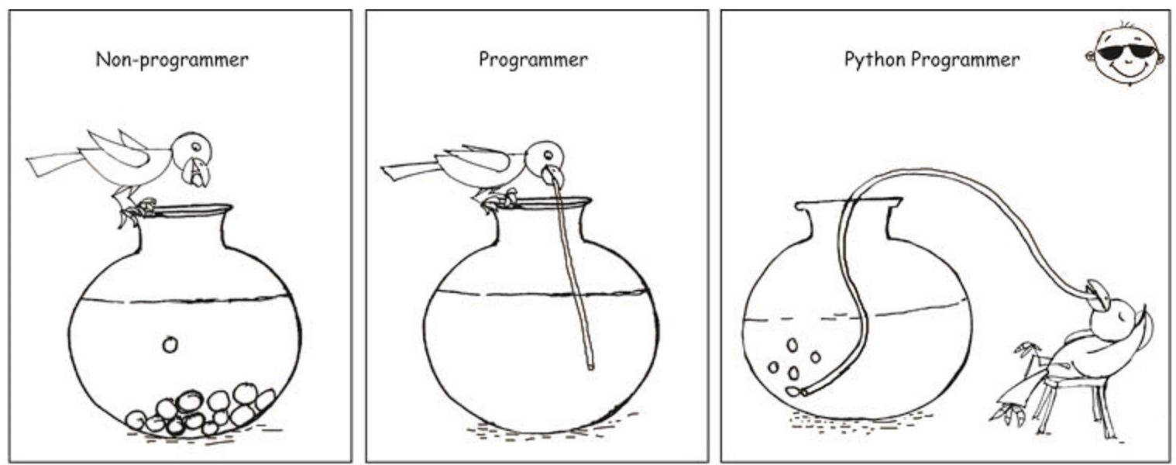
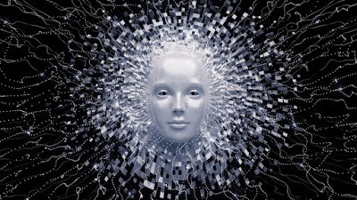

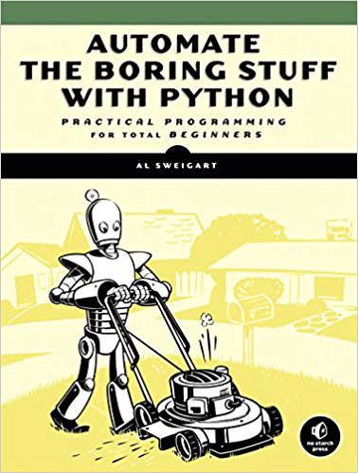
Why python?
Perfect to begin programming
Large Community
Artificial Intelligence
Machine Learning

Slide 4
Overview
Preparing PyCharm (15 minutes)
Python Syntax (Data and Expressions)
Control Structures and Conditions
Functions
Notes:
Python Syntax (Data and Expressions)
Control Structures and Conditions
Functions
File handling

Slide 5
Python Syntax (Data and expressions)
Comment
Keywords
First Program
Variables
Data Types
Arithmetic Operations
Converting data types

Slide 6
Control Structures and Conditions
Syntax
Indentation
Sequential control flow
Selection control flow
Iterative/Loop control flow (repetition)

Slide 7
Functions
Syntax
Defining functions
Types of functions
1. Non- value returning
2. Value returning
Calling function
Arguments and Parameters

Slide 8
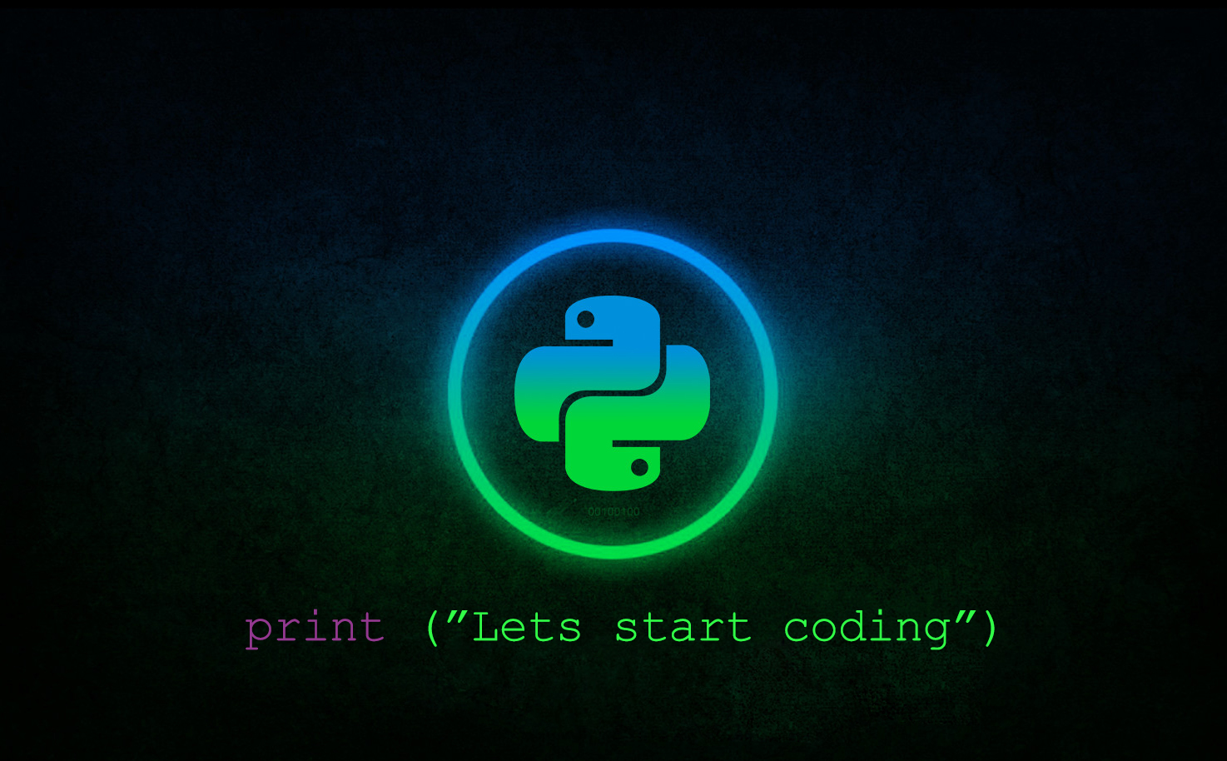

Slide 9
